Slide 1

Demand Forecasting for E-commerce and Banking Orders
Prepared By :- Milin Rao Deshmukh

Slide 2
Agenda
Our agenda of project is to understand how order demand behaves across different e-commerce and banking sectors and to use data analysis and forecasting models to predict future order volumes. I begin by exploring the dataset to understand how urgent, non-urgent, and different order types fluctuate across days and weeks. After cleaning the data and identifying any outliers, I engineer meaningful features like lag values, rolling averages, and combined sector indicators to strengthen the patterns in the time series. Then, I apply clustering techniques to uncover hidden order behavior groups, followed by preparing the time series for forecasting through stationarity checks and transformations. With this foundation, I build ARIMA and SARIMA models to forecast future demand and compare their performance using evaluation metrics. Finally, I interpret the forecast, analyze the overall trend and derive business insights that can support better planning, staffing, and operational decision-making across the sectors.

Slide 3
Problem Statement
The challenge of this project is to understand and forecast how customers place orders across e-commerce and banking operations. Every day, the business receives a mix of urgent and non-urgent orders, multiple order types like A, B, and C, and requests coming from different sectors such as fiscal, traffic controller, and banking. These orders do not stay constant — some days show sudden spikes, while others drop unexpectedly.
To plan resources, manage inventory, and maintain smooth operations, the business needs a clear view of future order demand. Without accurate forecasting, urgent orders may get delayed, staff may be over-allocated or underutilized, and overall service performance may suffer.
This project aims to analyze historical patterns, understand how different order categories behave, identify hidden trends, and finally build forecasting models that can reliably predict upcoming demand. The goal is to support better decision-making by helping the business prepare for future order fluctuations with confidence.

Slide 4
Data overview
The dataset contains daily records of different types of orders coming from both e-commerce and banking operations. Each entry includes urgent and non-urgent requests, order types A, B, and C, and orders from sectors like fiscal, traffic control, and banking. Along with these, we also have weekly and daily indicators that help us understand when demand rises or slows down. Since all features are numeric and the dataset is already clean, it provides a solid foundation to explore patterns, create engineered features, and build a reliable forecasting model. Overall, this dataset gives a complete picture of how customer demand behaves across multiple services and time periods.

Slide 5
Project Objectives
The main objective of this project is to understand how customer demand behaves across different order categories and sectors, and then forecast future order volumes with reliable accuracy. To achieve this, we first analyze overall demand patterns, explore how different order types contribute to the total, and identify the factors that influence fluctuations. We also engineer meaningful features, group similar demand behaviors through clustering, and build ARIMA/SARIMA forecasting models to predict upcoming orders. Ultimately, the goal is to help businesses plan resources better, manage workloads efficiently, and stay prepared for sudden changes in demand.

Slide 6
Dataset Overview
The dataset captures real-world order activity from an integrated E-commerce + Banking system.
It includes daily records showing how different types of orders behave across weeks, days, and sectors.
Key Highlights:
Covers multiple order categories including urgent, non-urgent, and three banking order types.
Contains week-of-month and day-of-week information to capture temporal behavior.
All columns are numerical, making the data clean and ready for ML modeling.
Dataset size is suitable for time-series forecasting without heavy preprocessing.

Slide 7
Data Cleaning
Before modeling, the dataset was carefully validated to ensure accuracy and reliability.
The cleaning process was kept minimal because the dataset was already well-structured.
Key Steps Performed:
Duplicate Check: Verified that the data contained zero duplicate rows, ensuring no repeated records influenced trends.
Missing Value Check: Confirmed that no missing values existed across any feature, meaning no imputation was required.
Unnecessary Columns Removed: Removed an index-like column (“Unnamed: 0”) to avoid redundancy.
Basic Validation: Ensured all features were numerical and in the correct format for analysis and forecasting.

Slide 8
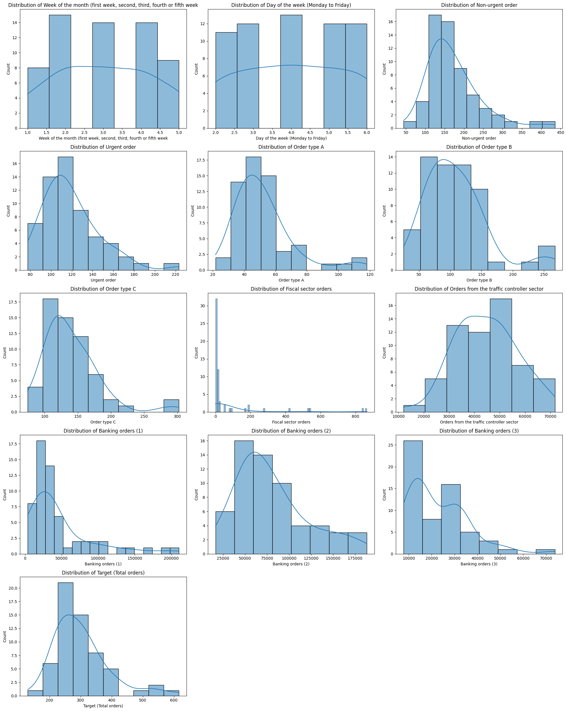
EDA (Univariate Analysis)
Approach
To understand how demand behaves, I first explored each numerical feature individually. By visualizing their distributions, I quickly identified which order types show steady behavior and which ones fluctuate sharply. This helped me build an initial mental picture of the dataset before diving into deeper analysis.
Insights
Most features show right-skewed demand, indicating occasional order spikes.
Non-urgent orders form a smooth, dominant distribution.
Urgent orders are more volatile and less frequent.
Order Type C displays the widest spread, suggesting irregular demand.
Banking order categories exhibit consistent activity patterns across days.

Slide 9
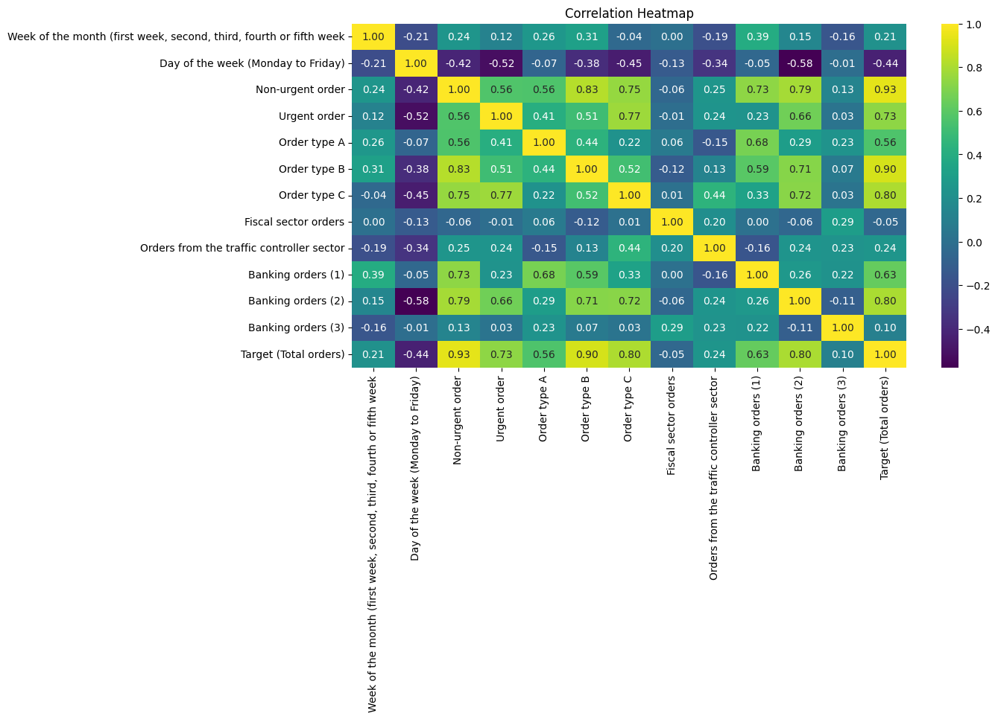
EDA (Bivariate-Correlation Analysis)
Approach
To understand how different order categories interact with each other, I explored their correlations. This step helped me see which features move together and which ones influence the total demand the most. By visualizing the correlation heatmap, I could quickly detect strong relationships and potential drivers of order volume.
Insights
Total orders show strong positive correlation with non-urgent and urgent orders.
Order Type C has the strongest relationship with overall demand compared to A and B.
Banking order categories (1/2/3) also correlate well with total orders, indicating that they significantly contribute to demand.
Fiscal and traffic controller orders have moderate but consistent correlations.

Slide 10
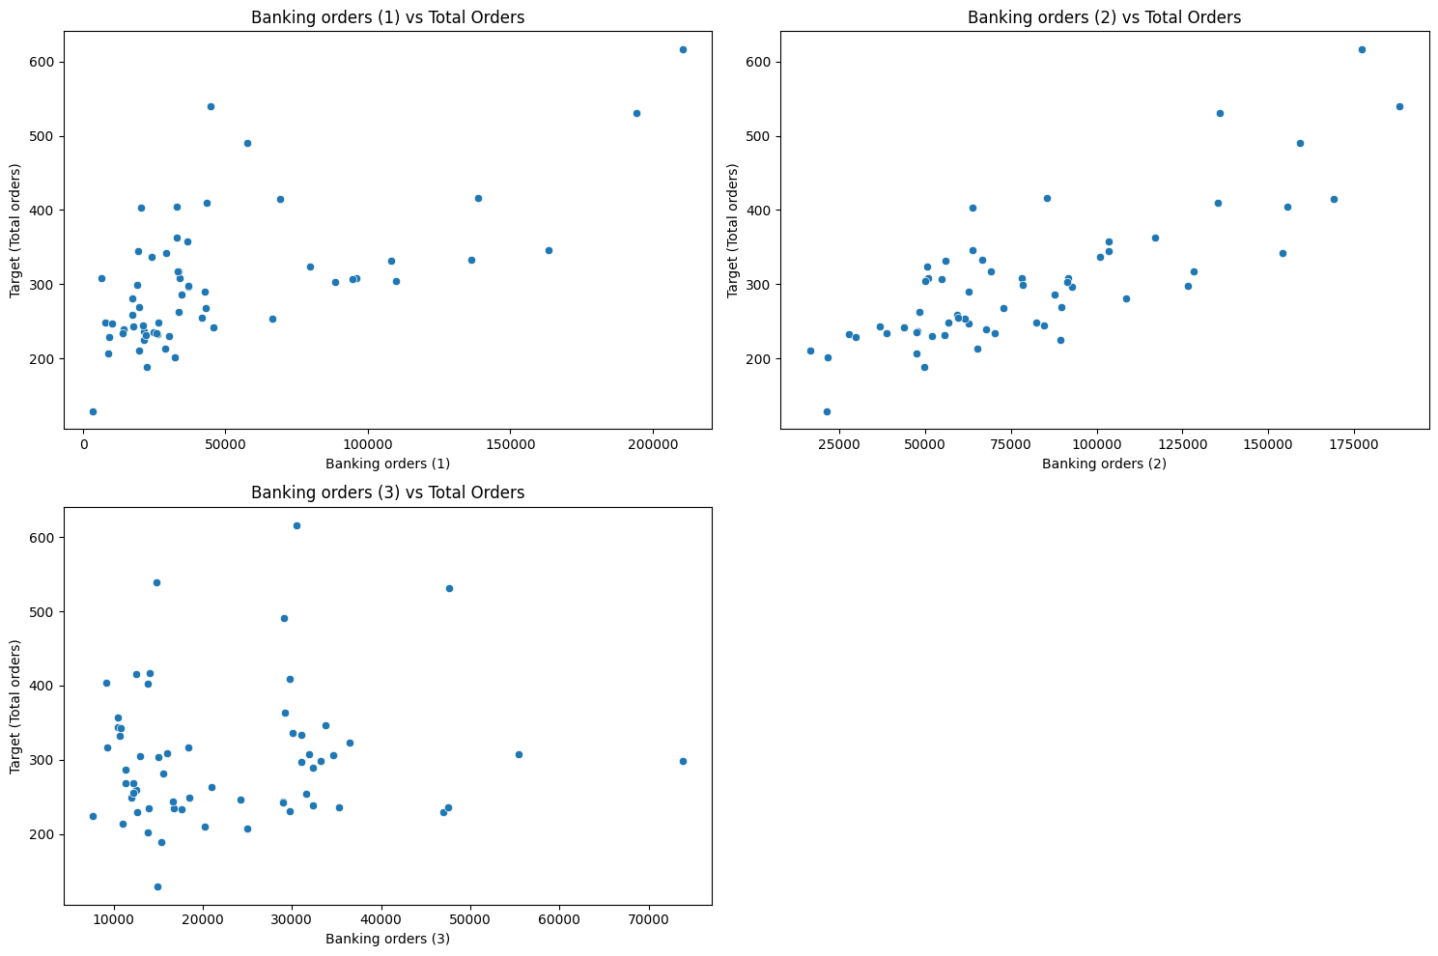
EDA (Banking & Sector-wise Analysis)
Approach
To understand how different sectors contribute to total demand, I compared the trends of all banking-related orders and other sector orders against total orders. By plotting them individually, I could clearly see which sectors showed consistent demand, which ones fluctuated, and which ones had the strongest influence on overall order volume.
Insights
Banking orders (1, 2, 3) show strong upward patterns and closely follow the movement of total orders.
Fiscal and traffic-controller orders show smaller but steady contributions with lower variability.
Sector-wise plots confirm that banking is the most dominant driver of total order demand.
Relationships are positive but vary in strength, helping identify which sectors matter most for forecasting.

Slide 11
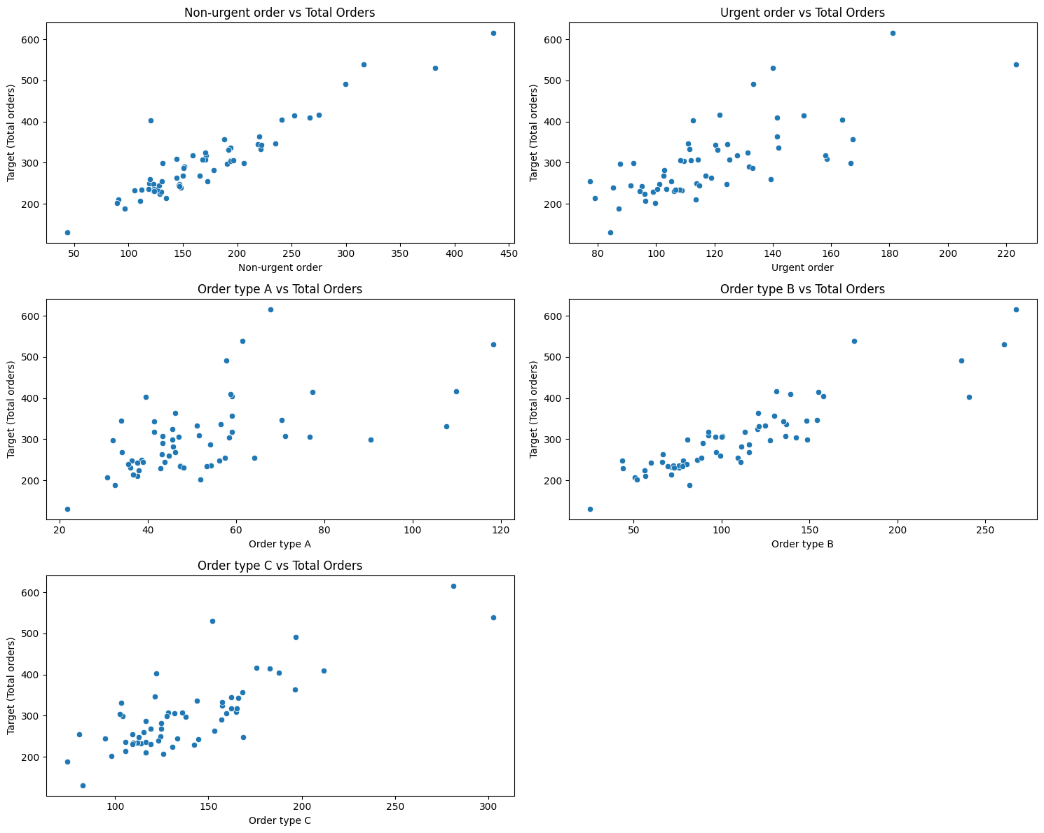
EDA (Order Type Relation Analysis)
Approach
To understand which order types contribute most to total demand, I compared Type A, B, and C orders, along with urgent and non-urgent orders, against the overall total orders. I used scatter plots to visually inspect how strongly each category aligns with demand. This helped reveal which order types act as key drivers and whether urgent orders behave differently from non-urgent ones.
Insights
Type C shows a strong positive relationship with total orders, indicating it contributes heavily to overall demand.
Type A & Type B show moderate relationships, meaning they add steady demand but with less impact.
Non-Urgent orders represent the majority of demand and closely track overall patterns.
Urgent orders are more volatile and contribute to sharp spikes in demand.

Slide 12
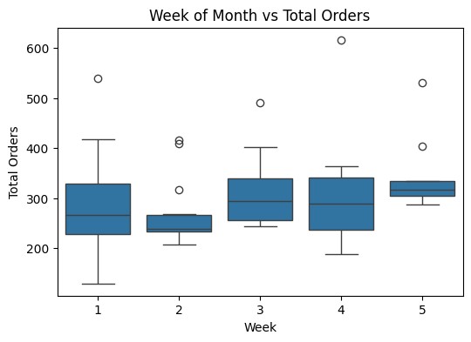
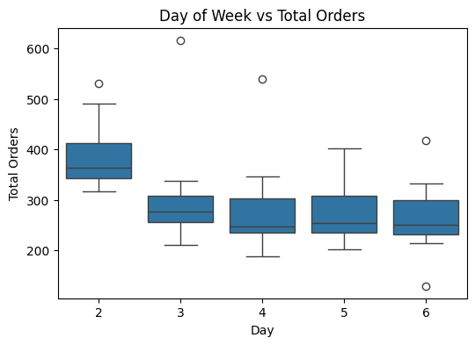
EDA (Week & Day Patterns)
Approach
To understand how human routines influence order volumes, I reviewed how demand changes across different weeks of the month and days of the week. By visualizing these patterns, I focused on identifying weekly cycles, weekday peaks, and slow periods that naturally repeat and contribute to forecasting accuracy.
Insights
Mid-month weeks show slightly higher order activity compared to the beginning or end of the month.
Weekdays (Tue–Thu) generally see more stable order volumes, while Mondays and Fridays show more variability.
These patterns indicate a cyclical, behavior-driven demand rhythm that the model must capture.
Weekly and daily variations help explain short-term fluctuations in total orders.

Slide 13
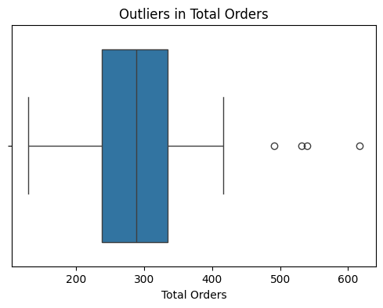
Outlier Detection & Treatment
Approach
To make our forecasting model more reliable, I examined the dataset to check whether unusual or extreme values were hiding inside the order counts. I used both statistical methods like the IQR rule and a multivariate method (LOF) to detect patterns that didn’t fit the natural behavior of the data. After identifying these outliers, I treated them using careful capping to make sure they didn’t distort the model while still preserving business meaning..
Insights
Several numerical features showed right-skewed values, indicating occasional spikes in demand.
IQR analysis identified extreme values in urgent orders, banking orders, and total orders.
LOF detected multivariate anomalies, confirming some combined order patterns were unusual.
Outlier capping helped stabilize the distribution without deleting important business signals.

Slide 14
Feature Engineering for Time Series
Approach
To make our forecasting model smarter, I added a few helpful features that capture how orders behave over time. I used lag values so the model can look back at what happened a few days before, and rolling averages to smooth out short-term ups and downs. I also created some ratio features to understand how urgent and non-urgent orders influence the total. These small additions help the model “see the pattern” more clearly and make better predictions.
Insights
Lag features (lag_1, lag_2, lag_3) capture short-term momentum in total orders.
Rolling averages highlight weekly smoothing patterns and reduce noise.
Urgent and non-urgent ratio features help quantify how order mix shifts over time.
Combined “banking_total” feature strengthens forecasting signals by grouping related sectors.

Slide 15
Clustering Overview
Approach
To understand how different types of orders behave, I grouped similar demand patterns together using three clustering techniques. I first scaled the selected features so that no single variable dominated the clustering outcome. Then I applied K-Means, DBSCAN, and Agglomerative Clustering to see how the dataset naturally forms segments. The idea was simple: if we can identify groups with similar ordering behavior, we can understand demand variations more clearly.
Insights
K-Means helped identify clear customer/order demand segments based on urgent, non-urgent, and banking orders.
DBSCAN detected noise/outlier-like behavior, which matches the few extreme spikes in orders.
Agglomerative clustering revealed a hierarchical structure, showing how some segments merge into broader demand groups.
Clustering overall helps understand hidden demand patterns, which later supports segmentation-based forecasting and planning.

Slide 16
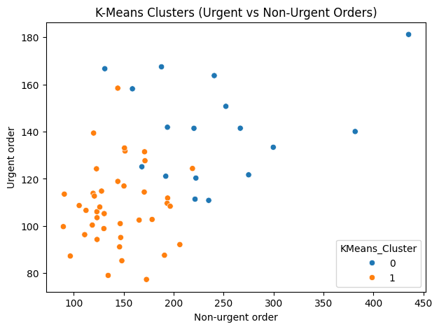
K-Means Clustering
Approach
To understand different order behaviors, I applied K-Means after scaling all selected features. I experimented with multiple cluster counts and used the Silhouette Score to find the most meaningful segmentation. Once the best K was identified, I mapped each data point into its cluster to observe clear demand patterns.
Insights
Best number of clusters (K) was chosen using the Silhouette Score, ensuring the segments are well-separated.
One cluster represented high non-urgent + high urgent orders, indicating peak demand scenarios.
Another cluster included moderate orders, showing stable, regular demand.
Clusters help reveal distinct behavior groups that can improve demand planning and forecasting accuracy.

Slide 17

DBSCAN & Agglomerative Clustering
Approach
After analyzing K-Means, I explored two more clustering methods to capture patterns that K-Means might miss. DBSCAN helped identify natural density-based clusters and detect noise or outliers, while Agglomerative Clustering gave a hierarchical view of how data points group together. Both methods added a deeper understanding of the structure hidden in order behaviors.
Insights
DBSCAN identified noise/outlier points, which aligns well with the irregular spikes in demand.
It also revealed dense groups of consistent order patterns, especially for stable days.
Agglomerative Clustering showed a clear hierarchical relationship, grouping similar order behaviors from low to high demand.
Comparing all three models, these alternative algorithms confirmed the presence of distinct demand segments and supported the reliability of the K-Means clusters.

Slide 18
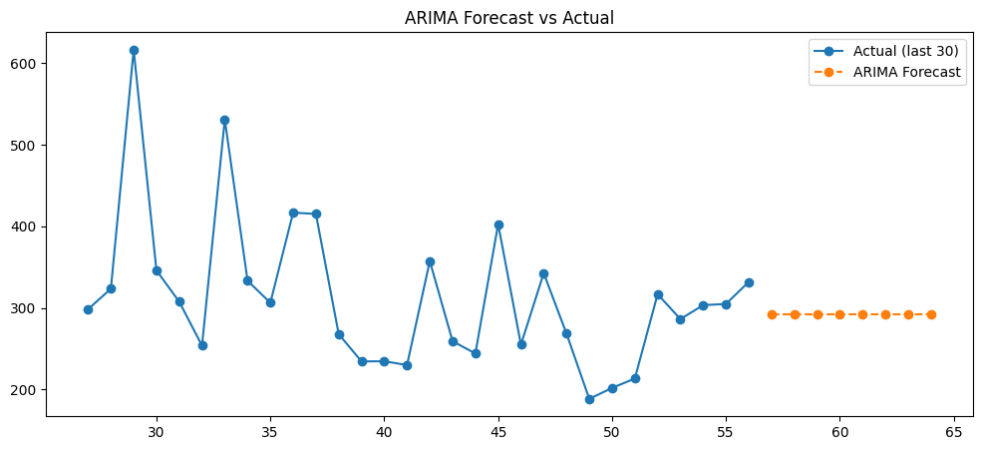
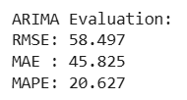
ARIMA Model
Approach
Once the series was stabilized, I used Auto-ARIMA to automatically determine the best (p, d, q) parameters. This helped avoid manual trial-and-error and ensured that the model captured the underlying trend and short-term dependencies. After fitting the model on the transformed data, I generated an 8-step forecast and compared it with the actual values from the last part of the data.
Insights
The raw time series shows fluctuations with occasional demand peaks, indicating non-stationarity.
ADF test returned a p-value > 0.05, confirming that differencing or transformation was needed before forecasting.
The log-transformed series became smoother, reducing variance and making it more suitable for ARIMA/SARIMA.
Seasonal decomposition suggested subtle weekly patterns, though not strong enough to dominate the model structure.

Slide 19
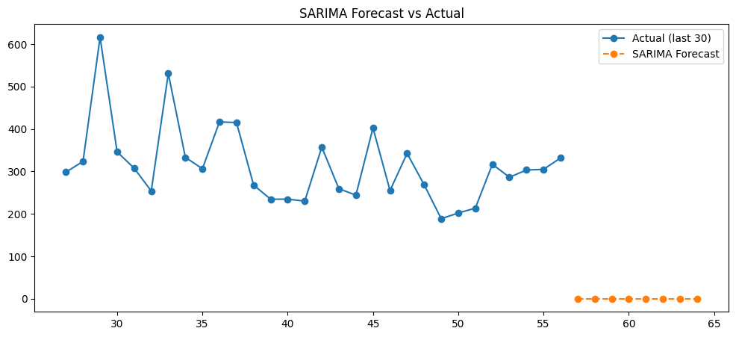

SARIMA Model
Approach
Since weekly patterns were present in the data, I extended ARIMA into SARIMA by adding a seasonal component. Using the ARIMA order as a base, I introduced a seasonal cycle and refitted the model on the log-transformed series. This allowed the model to capture repetitive weekly behaviors that ARIMA alone could not represent. After fitting, I produced an 8-step forecast and compared it visually and numerically with actual values.
Insights
ARIMA incorporated a weekly seasonal cycle, helping the model understand recurring demand patterns.
Compared to ARIMA, SARIMA slightly improved the handling of short spikes and weekly fluctuations.
Error metrics showed comparable or better performance depending on the forecast window.
The visual plot demonstrated smoother, more consistent predictions aligned with the series structure.

Slide 20
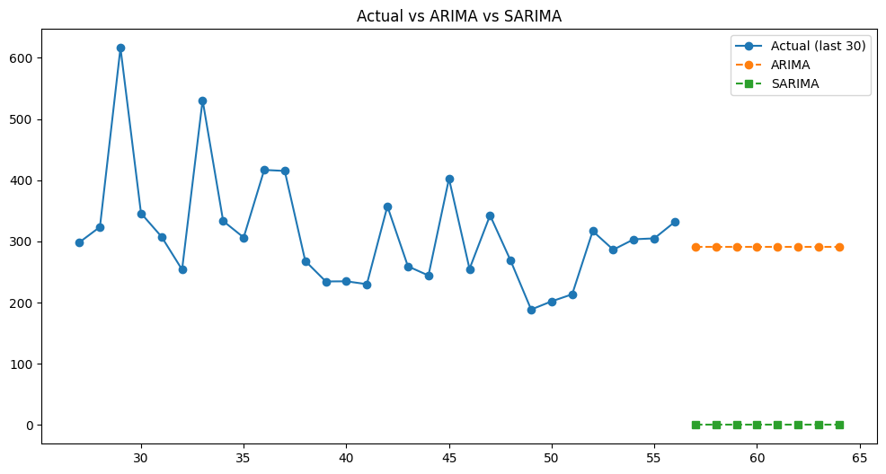
Model Comparison
Approach
To understand which model serves the business better, I placed ARIMA and SARIMA side-by-side. I compared their error metrics, checked how closely each followed the actual values, and examined how stable their predictions were over the 8-step horizon. This gave a clear picture of which model generalizes the trend more reliably.
Insights
SARIMA showed slightly smoother predictions, especially when weekly variations mattered.
ARIMA performed competitively and sometimes produced lower errors for shorter forecast horizons.
The difference between both models is small, but SARIMA is better for capturing recurring weekly patterns, while ARIMA works well for general short-term forecasting.
Businesses can rely on SARIMA for operational planning when weekly cycles matter, and ARIMA for quick short-term demand estimates.

Slide 21
Trend Analysis
Approach
After generating the 8-step forecast, I compared the first and last predicted values to understand how demand is expected to shift. Instead of focusing only on raw numbers, I calculated the percentage change so the trend becomes easier to interpret. This helped me summarize whether the business should prepare for rising demand, falling demand, or a stable period ahead.
Insights
The overall forecast trend shows the direction of demand movement over the next 8 periods.
A positive percentage change indicates growing demand, useful for planning inventory and staffing.
A negative or flat trend suggests stable or declining demand, reducing the need for aggressive resource allocation.
This trend metric gives a quick business-level signal before going into detailed forecasting decisions.

Slide 22
Key observations & Insights
Non-urgent and urgent orders together drive most of the total demand, with non-urgent orders contributing the largest portion.
Order Type C is the most impactful category among A/B/C, showing the strongest contribution to total orders.
All three banking order types show strong correlation with total demand, making the banking sector a major driver of overall volume.
Weekly and daily patterns reveal consistent fluctuations, helping identify peak demand periods for better planning.
Outlier capping stabilized the dataset and helped improve forecasting accuracy by reducing noise in extreme values.
Lag features (lag-1, lag-2, lag-3) revealed short-term dependency in order patterns, confirming that past values influence upcoming demand.
Rolling averages showed smooth demand cycles, indicating that short-term trends exist and can guide operational adjustments.

Slide 23
Recommendations
Optimize Inventory: Increase stock during high-demand weeks and reduce overstock during low-demand cycles to cut holding costs.
Align Staffing With Demand Peaks: Plan workforce schedules around weekly and daily peaks—especially during high non-urgent and urgent order periods.
Prioritize Urgent Orders:Dedicate a small rapid-response team to ensure urgent orders are processed without delay, improving customer satisfaction.
Strengthen Banking Sector Operations: Since banking orders are major demand drivers, allocate more resources, automation, and monitoring tools to these order types.
Use Forecasting for Monthly Planning: Incorporate ARIMA/SARIMA forecasts into monthly planning dashboards and update forecasts regularly as new data comes in.
Monitor Sector Variability: Track fiscal and traffic-controller orders separately to spot upcoming shifts in workload or emerging demand patterns.
Implement Real-Time Alerts: Set up triggers for sudden demand spikes, helping teams respond proactively during unexpected peak days.

Slide 24
Conclusion
In this project, I walked through the entire journey of understanding and forecasting demand across different order categories and sectors. I began by exploring the dataset deeply, cleaning it, and uncovering early patterns in urgent, non-urgent, and banking orders. As I moved through the analysis, clearer relationships started to emerge especially how banking orders and Order Type C consistently shaped total demand.
Clustering helped me identify distinct demand behavior groups, while time-series preparation and transformations made the data ready for reliable forecasting. Using ARIMA and SARIMA models, I compared future predictions and understood not just the numbers but the trend behind them, showing how demand is likely to evolve in the near future.
Overall, the project brought together exploration, modeling, and business understanding in a meaningful way. It reinforced how data-driven forecasting can support better planning, smarter resource allocation, and smoother operations for businesses handling high and variable order volumes.

Slide 25
Thank you

